Slide 1
Classification Case Study Using German Credit Data
Stat 6850: Applied data mining
Western Michigan university

Slide 2
OBJECTIVE
The main objective of this case study is to be able to classify the bank clients using a known set of variables given in the dataset.
The outcome is either a customer is considered credit worthy (good) or not (bad).
Identify the best method for classifying the clients and identify most significant factors that affect this decision making.

Slide 3
THE DATASET
The dataset is comprised of 1000 observations and 20 independent variables.
7 numerical variables: Duration, Credit Amount, Installment Rate, Residence, Age, Credits, People Liable
13 categorical variables: Checking Account, Purpose, Saving Account, Status, Debtor Guarantor, Property, Other Installment, Housing, Phone, Foreign Worker, Risk

Slide 4
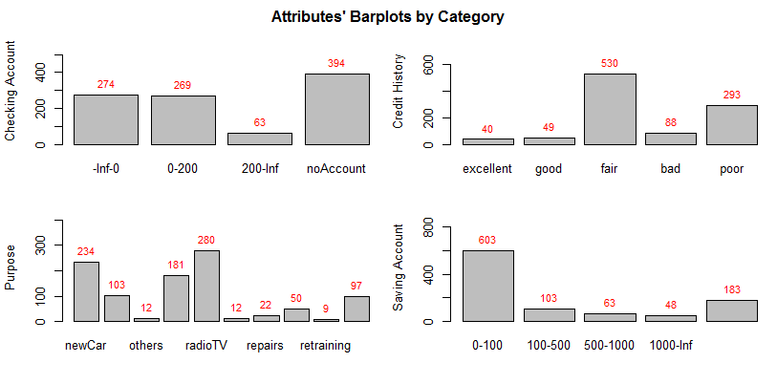
EXPLORATORY ANALYSIS - BARPLOTS
Most of the clients do not have a checking account.
Most clients’ credit history is distributed between fair and poor.
Clients are usually buying furniture and cars.
Most clients have [0-100] in their saving account.

Slide 5
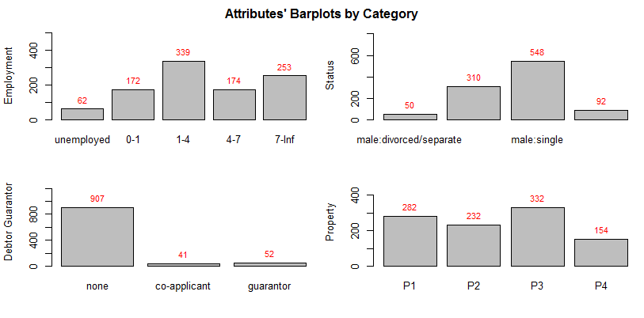
EXPLORATORY ANALYSIS - BARPLOTS
Employment duration has high variability.
Most clients are male and single.
Almost every client has no debtor guarantor.
Most clients’ properties are distributed somewhat evenly.

Slide 6
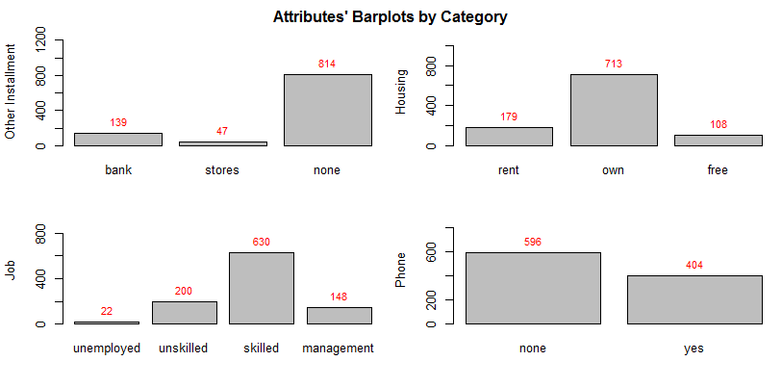
EXPLORATORY ANALYSIS - BARPLOTS
Almost every client doesn’t have other installments.
Most clients own housing.
Most clients have skilled jobs.
Clients having phone are well distributed.

Slide 7
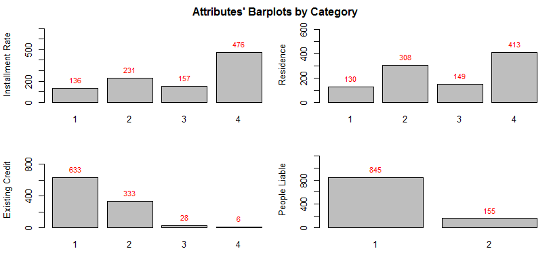
EXPLORATORY ANALYSIS - BARPLOTS
Clients usually have high installment rate (4%).
Most clients have residence more than 3 years.
Clients have one to two existent credit accounts.
Most clients have only one people liable.

Slide 8
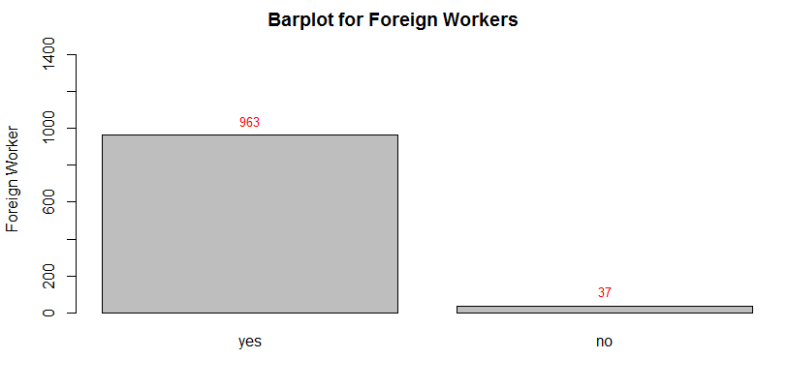
EXPLORATORY ANALYSIS - BARPLOTS
Almost every client is a foreign workers.

Slide 9
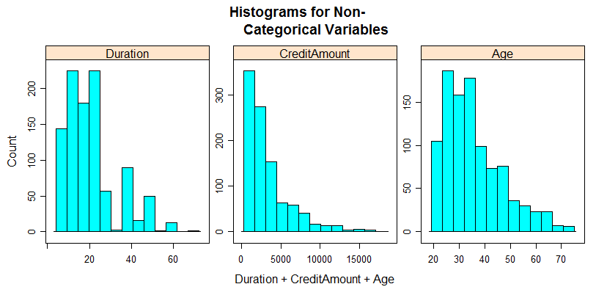
EXPLORATORY ANALYSIS - HISTOGRAMS
The histogram was applied for the three non categorical variables age (skewed to the
right), duration (also skewed to the right), and credit amount (looks exponentially
distributed) as shown.

Slide 10
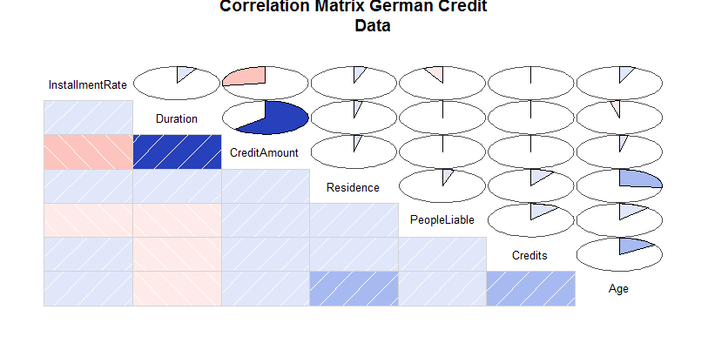
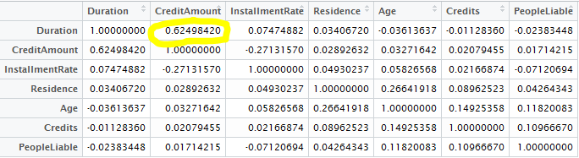
EXPLORATORY ANALYSIS – CORRELATION MATRIX
A correlation matrix was run for numerical variables.
Some correlation was found between Credit Amount and Duration with a r=0.625 as seen.
A Correlogram is shown for other attributes for comparison purposes.

Slide 11
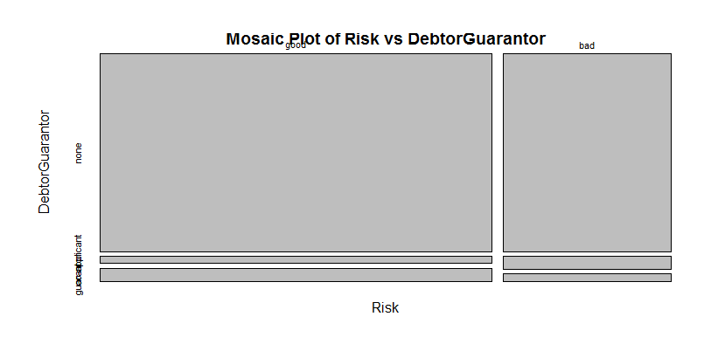
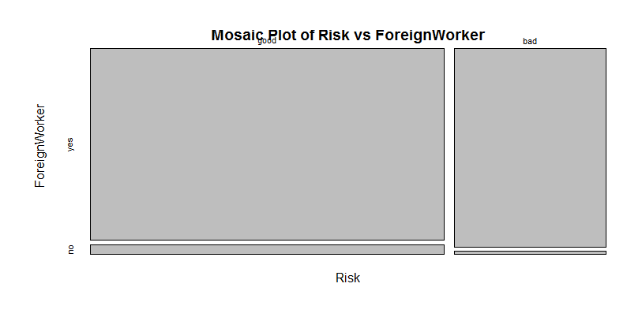
EXPLORATORY ANALYSIS – CORRELATION MATRIX
After assessing using exploratory analysis, we found two significant variables that can be potentially removed: Foreign Workers and Debtor Guarantor.
We used a 90-10% cutoff for variance to identify these variables.
Mosaic plots show the variability of these attributes vs. Risk.

Slide 12
DATA PARTITIONING
The German Credit Data set was randomly split into train set and test set with approximately 60%/40% proportion of Risk responses.
The structure of the original good:bad (70%:30%) credit distribution in both the train set and the test set was considered
(420/180 for good/bad) cases for train set and 400 (280/120 for good/bad) cases for test set.

Slide 13

COST STRUCTURE
We ran these methods adjusting the priors to their original proportion (70%/30%) and also based on a costing structure as given in the dataset statement -- “It is worse to class a customer as good when they are bad (5), than it is to class a customer as bad when they are good (1)”.
The table shows the calculations for original proportion and cost adjusted priors

Slide 14
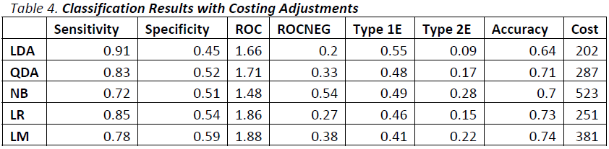
CLASSIFICATION RESULTS (COST ADJUSTMENT)
After cross-validation trainings, we used all models with the Test set to compare the errors from these five methods.
In contrast to results when fitting the train set, on the Test set LDA has the highest Sensitivity, lowest Specificity and lowest overall cost.
While NB now shows the worst Sensitivity and also the highest cost.

Slide 15
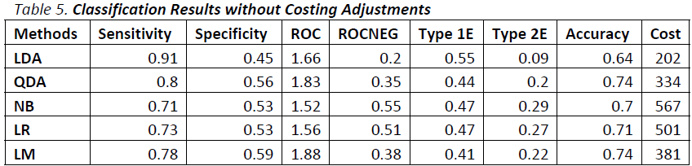
CLASSIFICATION RESULTS (NO COST ADJUSTMENT)
The above table shows these metrics w/o adjusting priors for cost, and again LDA and NB are significantly different.
LDA is a better classifier method based on results.
Comparing these figures we saw that Logistic Regression improved significantly in terms of Sensitivity and Cost, indicating this method is sensible to prior adjustments.

Slide 16
CONCLUSION
When considering cost adjusted prior (good=1, bad=5), Linear Discriminant Analysis and Logistic Regression are the best classifying methods for this dataset.
When considering NO cost adjusted prior (good=1, bad=1), Linear Discriminant Analysis and Quadratic Discriminant Analysis are the best classifying methods for this dataset.

